Slide 1


Pizza Sales SQL Queries
A. KPI’S
1. Total Revenue
SELECT SUM(total_price) AS Total_Revenue FROM pizza_sales;
2. Average Order Value
SELECT SUM(total_price)/COUNT(order_id) AS Avg_Order_Value FROM pizza_sales;

Slide 2



3. Total Pizza Sold
SELECT SUM(quantity) AS Total_Pizza_Sold FROM pizza_sales;
4. Total Orders
SELECT COUNT(DISTINCT order_id) AS Total_Orders FROM pizza_sales;
5. Avg Pizzas Orders Per Order
SELECT SUM(quantity) / COUNT(DISTINCT order_id) AS Total_Orders FROM pizza_sales;

Slide 3
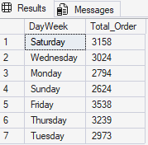
B. Daily Trends For Total Orders
SELECT DATENAME(DW,order_date) AS DayWeek,
COUNT(DISTINCT order_id) AS Total_Order
FROM pizza_sales
GROUP BY DATENAME(DW,order_date);
C. Monthly Trends For Total Orders
SELECT DATENAME(Month, order_date) AS Month_Name,
COUNT(DISTINCT order_id) AS Total_Orders
FROM pizza_sales
GROUP BY DATENAME(Month, order_date);

Slide 4
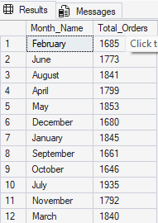
D. % Of Total Sales By Category
SELECT pizza_category, CAST(SUM(total_price) AS DECIMAL(10,2)) AS Total_Revenue,
CAST(SUM(total_price)*100/
(SELECT SUM(total_price)
FROM pizza_sales
WHERE MONTH(order_date) = 1) AS DECIMAL(10,1)) AS PCT
FROM pizza_sales
WHERE MONTH(order_date) = 1
GROUP BY pizza_category;

Slide 5
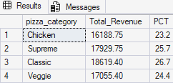
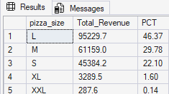
E. % Of Total Sales By Size
SELECT pizza_size, CAST(SUM(total_price) AS DECIMAL(10,1)) AS Total_Revenue,
CAST(SUM(total_price)*100/(SELECT SUM(total_price) FROM pizza_sales
WHERE DATEPART(quarter,order_date) = 1) AS DECIMAL(10,2)) AS PCT
FROM pizza_sales
WHERE DATEPART(quarter,order_date) = 1
GROUP BY pizza_size
ORDER BY PCT DESC;

Slide 6
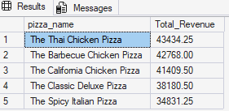
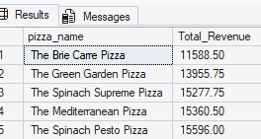
F. TOP 5 PIZZA BY REVENUE
SELECT TOP 5 pizza_name,
CAST(SUM(total_price) AS DECIMAL(10,2)) AS Total_Revenue
FROM pizza_sales
GROUP BY pizza_name
ORDER BY SUM(total_price) DESC;
G. BOTTOM 5 PIZZA BY REVENUE
SELECT TOP 5 pizza_name,
CAST(SUM(total_price) AS DECIMAL(10,2)) AS Total_Revenue
FROM pizza_sales
GROUP BY pizza_name
ORDER BY SUM(total_price) ASC;

Slide 7
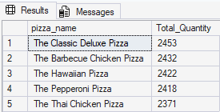
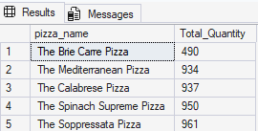
H. TOP 5 PIZZA BY QUANTITY
SELECT TOP 5 pizza_name, SUM(quantity) AS Total_Quantity
FROM pizza_sales
GROUP BY pizza_name
ORDER BY Total_Quantity DESC;
I. BOTTOM 5 PIZZA BY QUANTITY
SELECT TOP 5 pizza_name, SUM(quantity) AS Total_Quantity
FROM pizza_sales
GROUP BY pizza_name
ORDER BY Total_Quantity ASC;

Slide 8
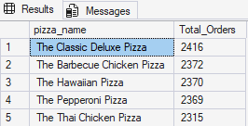
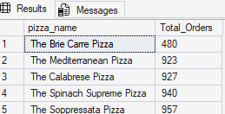
J. TOP 5 PIZZA BY ORDER
SELECT TOP 5 pizza_name, COUNT(order_id) AS Total_Orders
FROM pizza_sales
GROUP BY pizza_name
ORDER BY Total_Orders DESC;
K. BOTTOM 5 PIZZA BY ORDER
SELECT TOP 5 pizza_name, COUNT(order_id) AS Total_Orders
FROM pizza_sales
GROUP BY pizza_name
ORDER BY Total_Orders ASC;

